Slide 1


Centralized Hackathon Management Portal
Theme- SDG 4:Quality Education (Promoting skill development and collaborative learning)
Category- Software
Group No - 13
Group Members – Shriya Supekar
        Raj Surve
        Vivek Singh
        Sumiran Pote
Guide- Prof. Poonam Tiware
Hackathon
Hackathon
Hackathon
Hackathon

Slide 2
Outline
Introduction
Literature Survey
Limitations of existing systems
Problem statement and Objectives
Proposed Methodology
Experimental Setup
Implementation
Results & Analysis
Conclusion and Future work
References

Slide 3
Introduction
Background & Importance
Centralized Bulletin: A public management portal where college coordinators post and oversee hackathon events and students can access it.
Information Hub: Acts as a singular source for all event-related tracks, rules, and problem statements.
Current Challenges & Motivation
Access Barriers: Traditional systems often require tedious student account creation just to view basic event details.
Motivation: Observations of students losing time or missing updates due to scattered information about hackathons.

Slide 4
Introduction
Project Objectives
Simplified Flow: Availability of student accounts to ensure immediate access to event data.
Unified Admin Control: Provide coordinators with a secure "Coordinator-Only" login to manage events and broadcast live updates.
Security Integration: Utilize Supabase Row Level Security (RLS) to solve the issue of unauthorized data modification.

Slide 5
Literature Survey
Platform Name | Techniques/Methods Used | Key Results | Limitations for Local College Use
Devpost | Global cloud-based hub; Project galleries; Peer voting systems. | The industry standard for documenting "artifacts" (what was built, tools used, and demos). | High complexity for small internal events; lack of localized college-specific notification systems.
Unstop (formerly Dare2Compete) | Student-centric login; AI-proctoring; Centralized student data repository. | One-stop platform for assessments, competitions, and placement tracking. | Features are often locked behind corporate/pro tiers; can feel "overcrowded" with external ads.
HackerEarth (Sprint) | Automated evaluation; Real-time leaderboards; Plagiarism detection. | Highly effective for large-scale technical assessments and corporate hiring hackathons. | Primarily targets hiring/recruitment; complex setup for non-technical or localized campus events.
Major League Hacking (MLH) Guide | Open-source playbooks; OrganizerHQ (OHQ) for registration. | Provides a standardized "playbook" and free registration tools for 65,000+ student developers. | Relying on third-party registration tools (OHQ) means the college doesn't "own" its historical archive.

Slide 6
Limitations of existing Systems
Limitations of Existing Systems
Data Fragmentation: Many current solutions lack a centralized archive, leading to a loss of historical event data.
Complex Architectures: Surveyed platforms often have complex database schemas that increase development time and maintenance difficulty.

Slide 7
Problem statement and Objectives
Problem Statement
The management of college-level hackathons is currently impeded by fragmented communication channels, such as WhatsApp and email, resulting in significant information lag and the loss of historical event data. This project aims to rectify these inefficiencies by establishing a secure, centralized portal that serves as the definitive "Source of Truth" for students and coordinators.

Slide 8
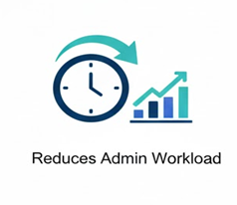

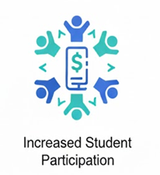


Problem statement and Objectives
Objectives
Tiered Authentication: Implement secure login protocols for both students and coordinators to ensure personalized and authorized access to event resources.
Administrative Centralization: Develop a dedicated dashboard for coordinators to post, modify, and archive event tracks, rules, and problem statements.
Real-Time Communication: Facilitate instantaneous information dissemination through a live announcement broadcast feature to eliminate fragmented messaging.
Data Integrity and Security: Deploy Supabase Row Level Security (RLS) to strictly restrict data modification capabilities to authenticated administrative accounts.
SDG 4 Integration: Promote Quality Education by democratizing access to technical competitions and maintaining a permanent digital archive of student achievements.

Slide 9

Proposed Methodology
Frontend (User Interaction): React,CSS
Backend (Logic & Processing): JavaScript, SQL
Database (Storage): Supabase
Hosting (Deployment): Vercel

Slide 10
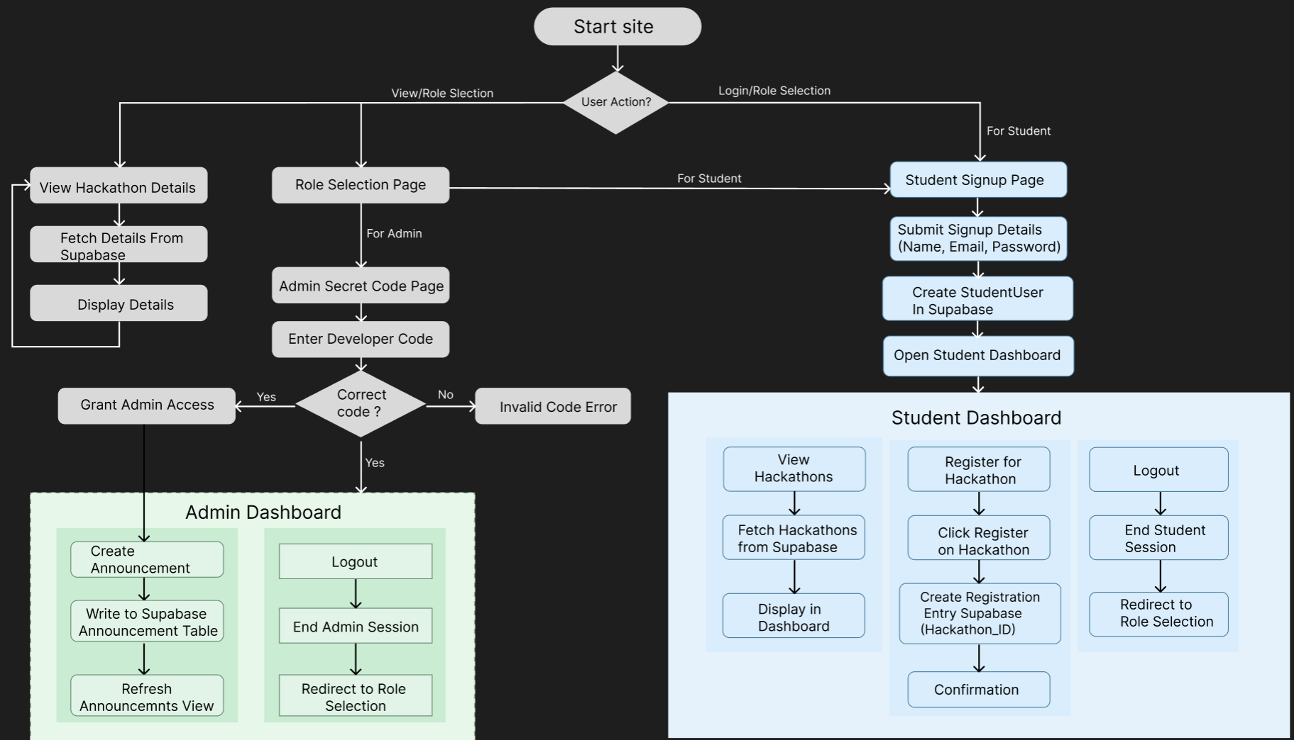

Slide 11
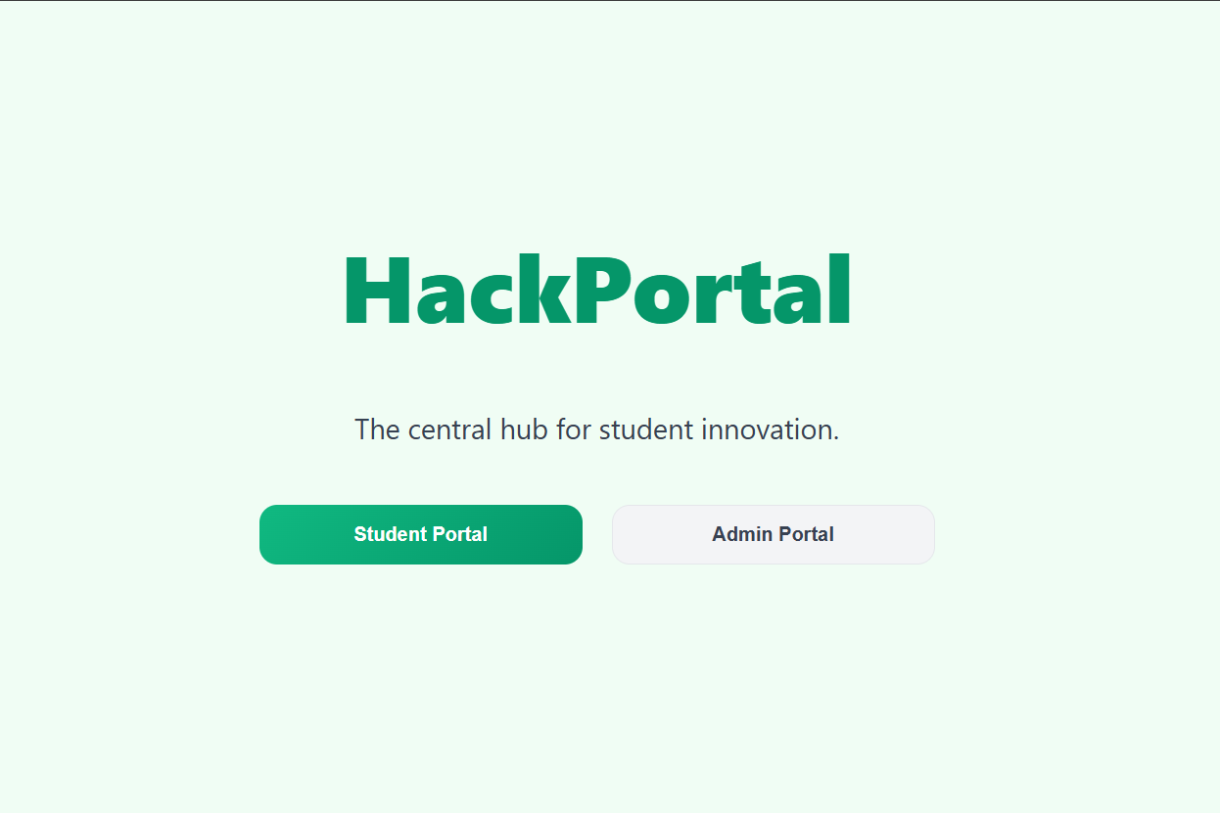
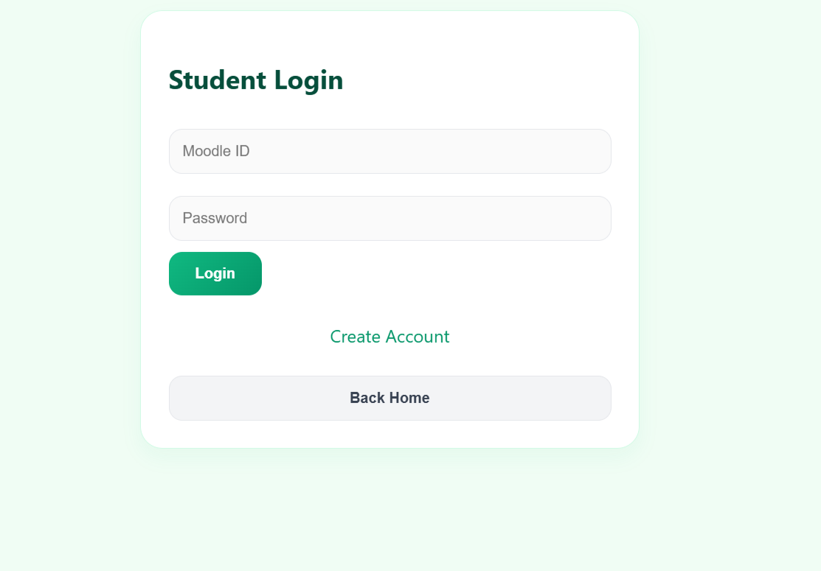
Implementation

Slide 12
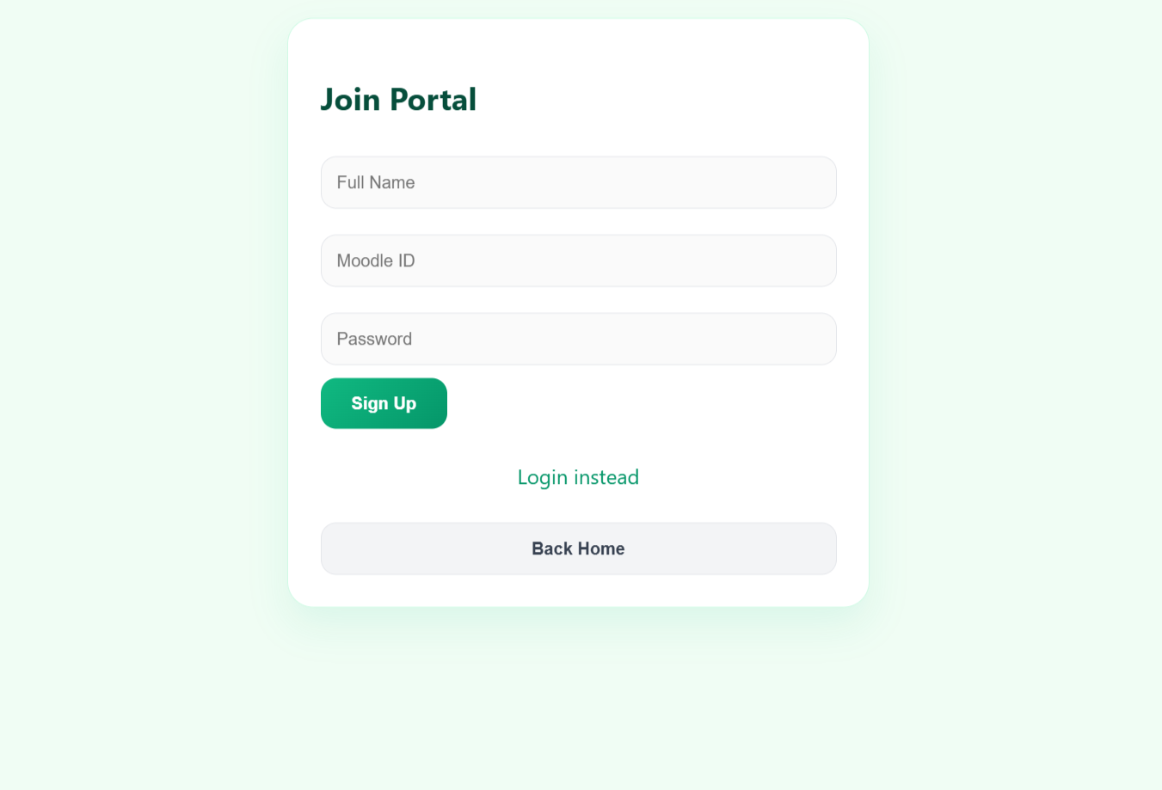
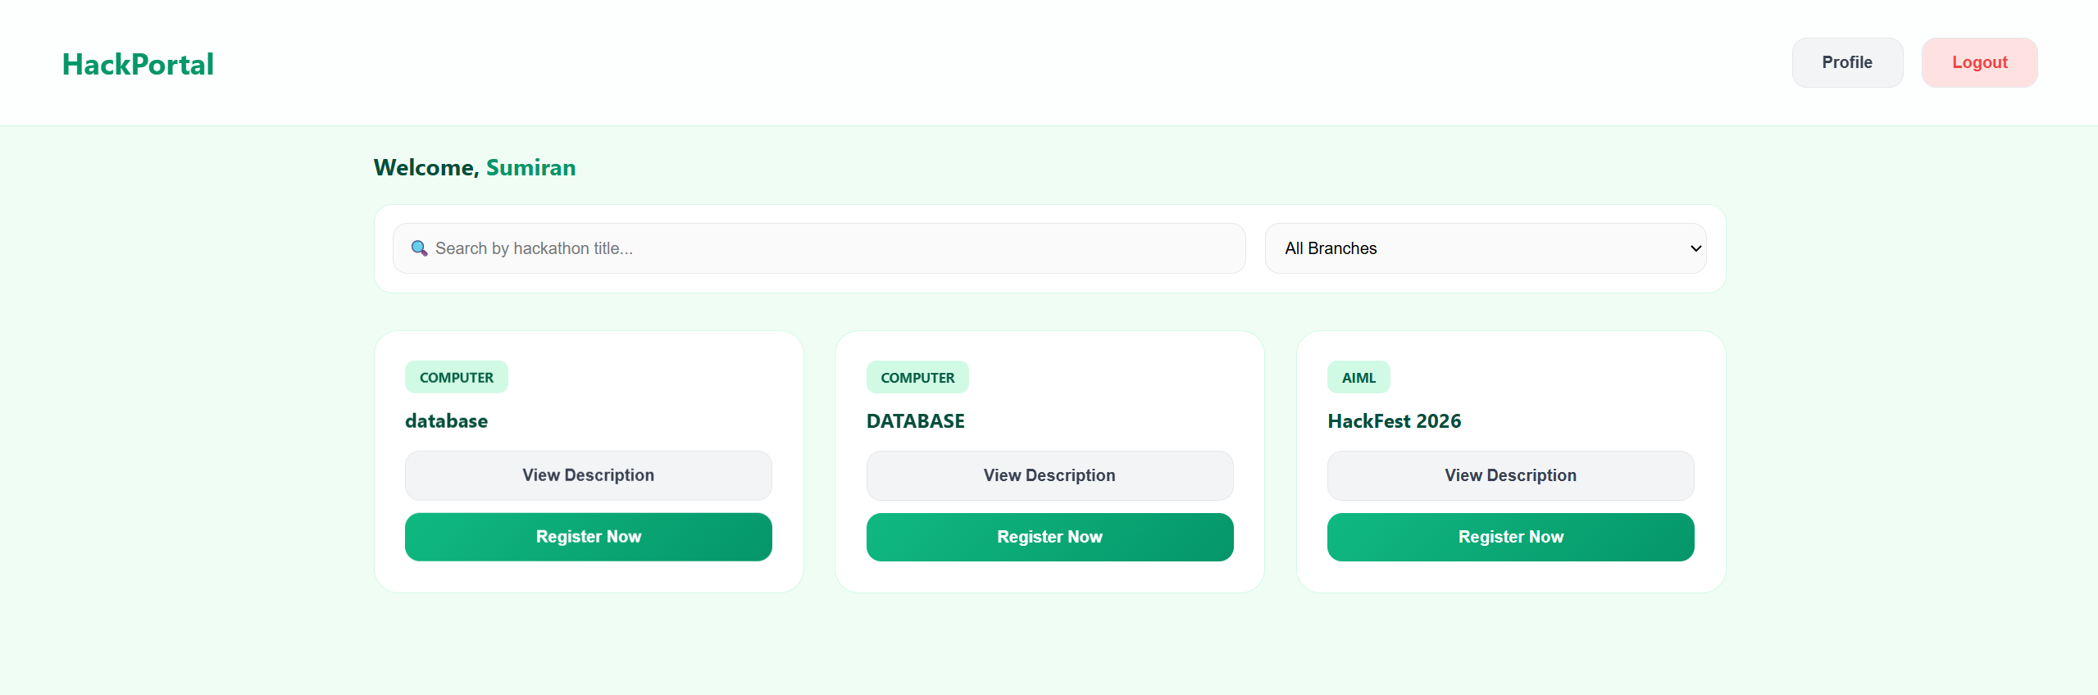

Slide 13
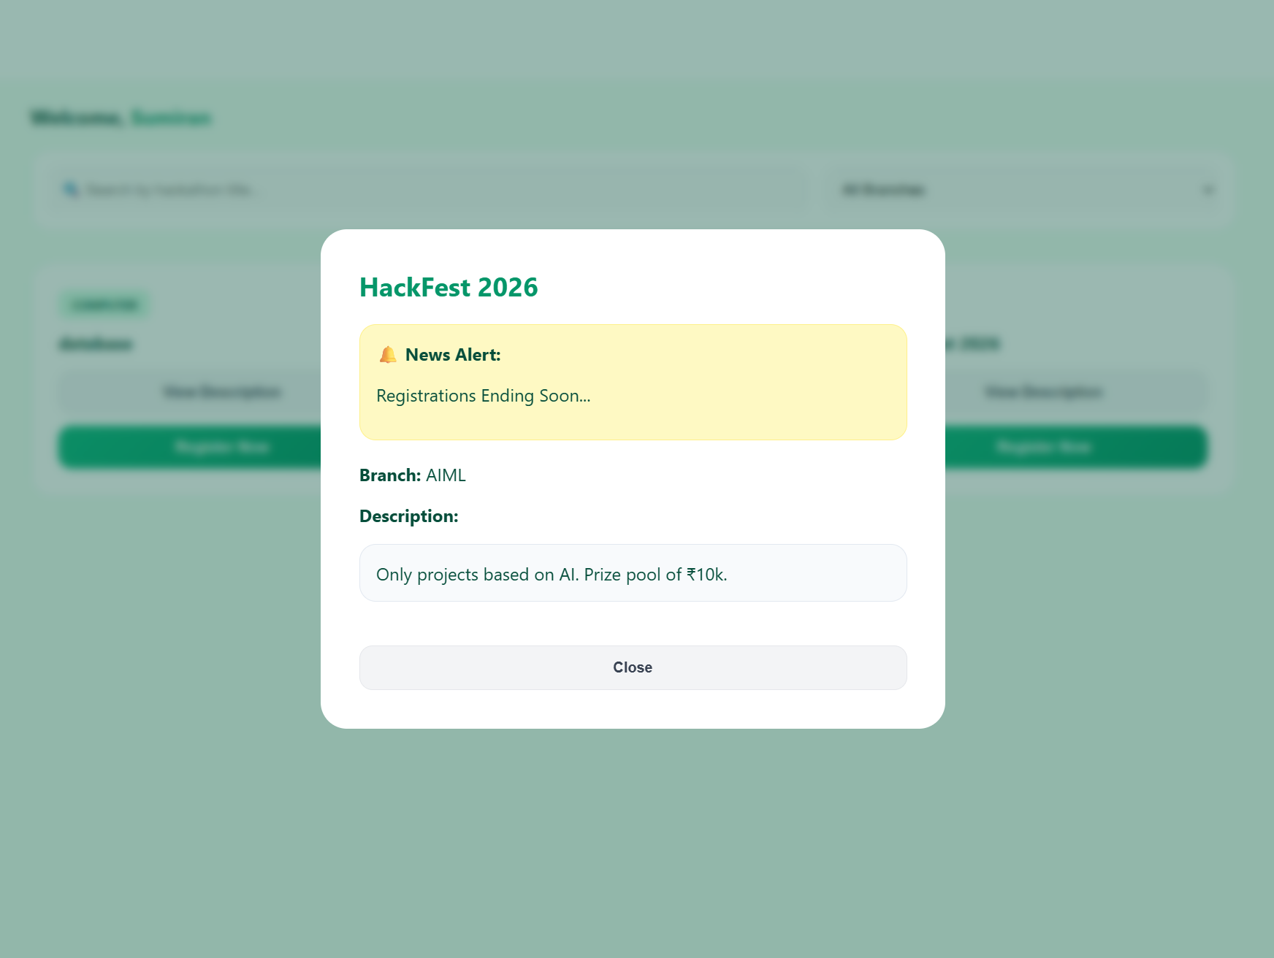
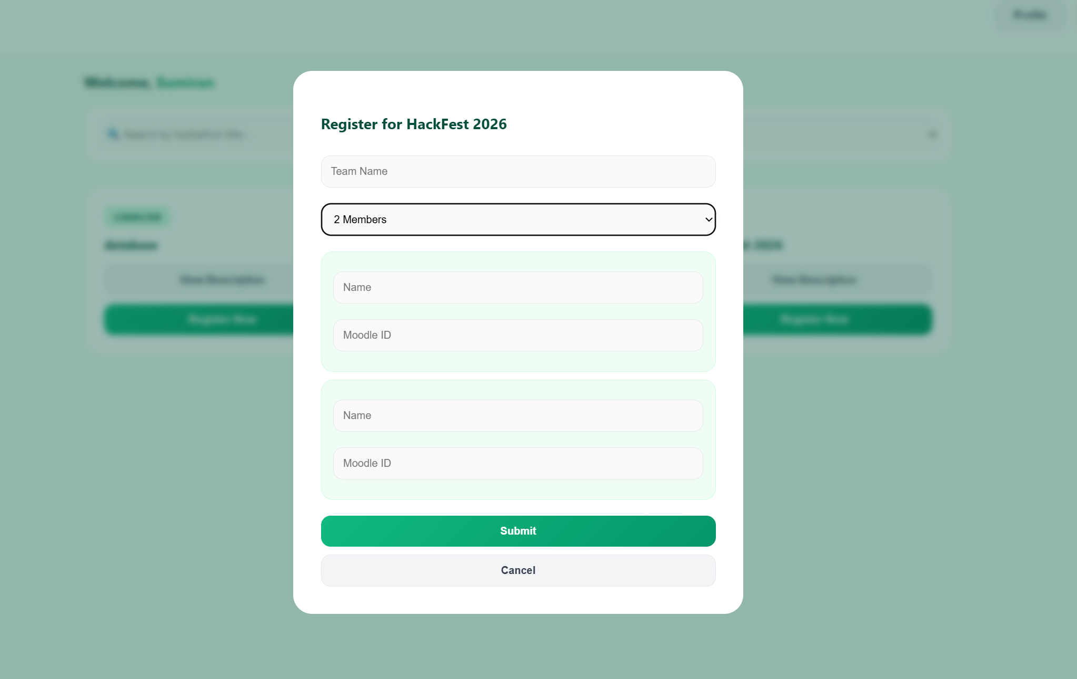

Slide 14
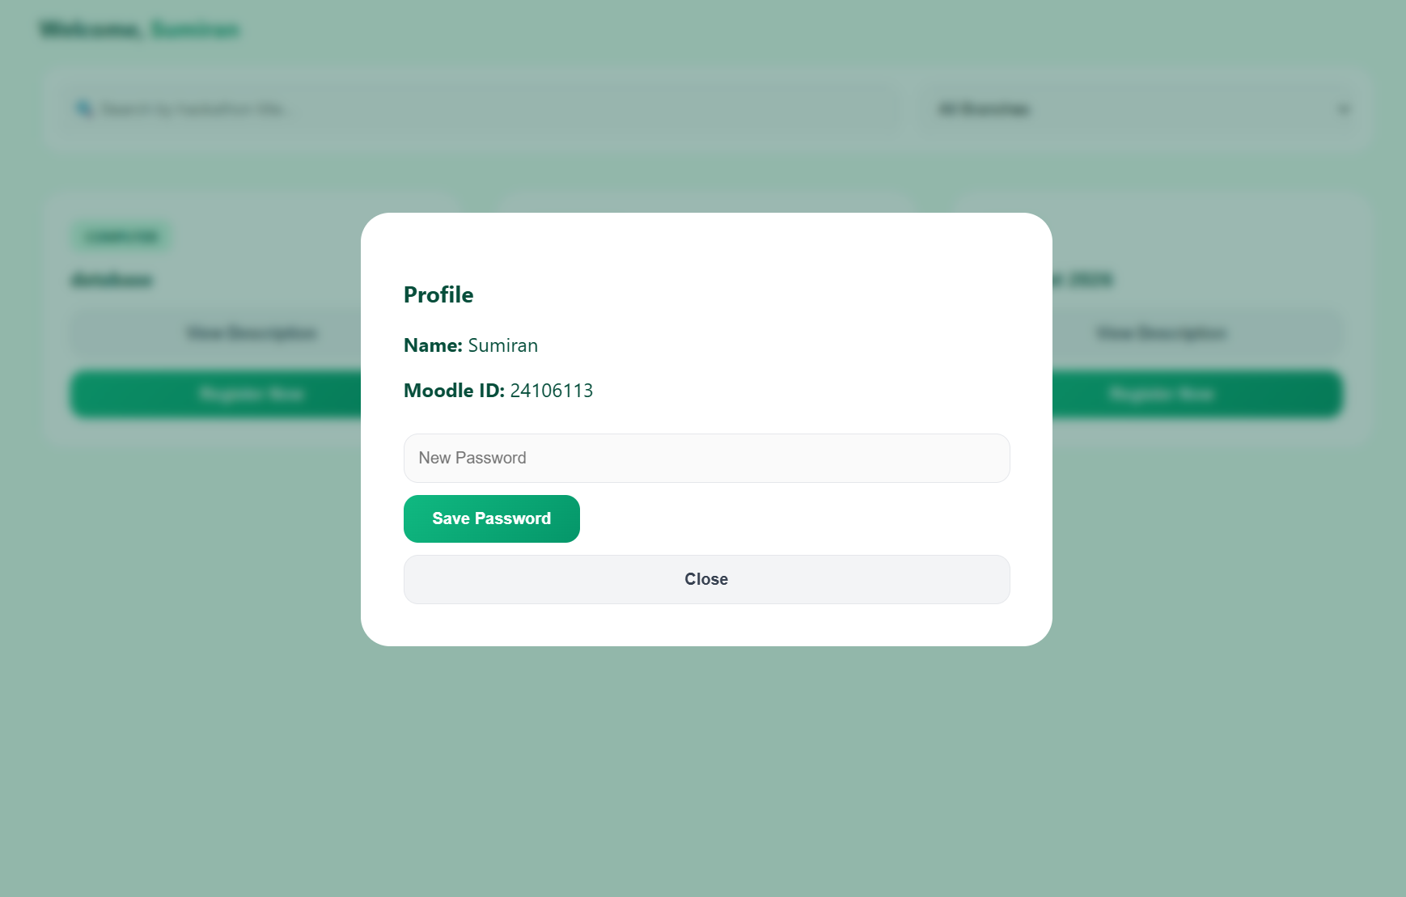
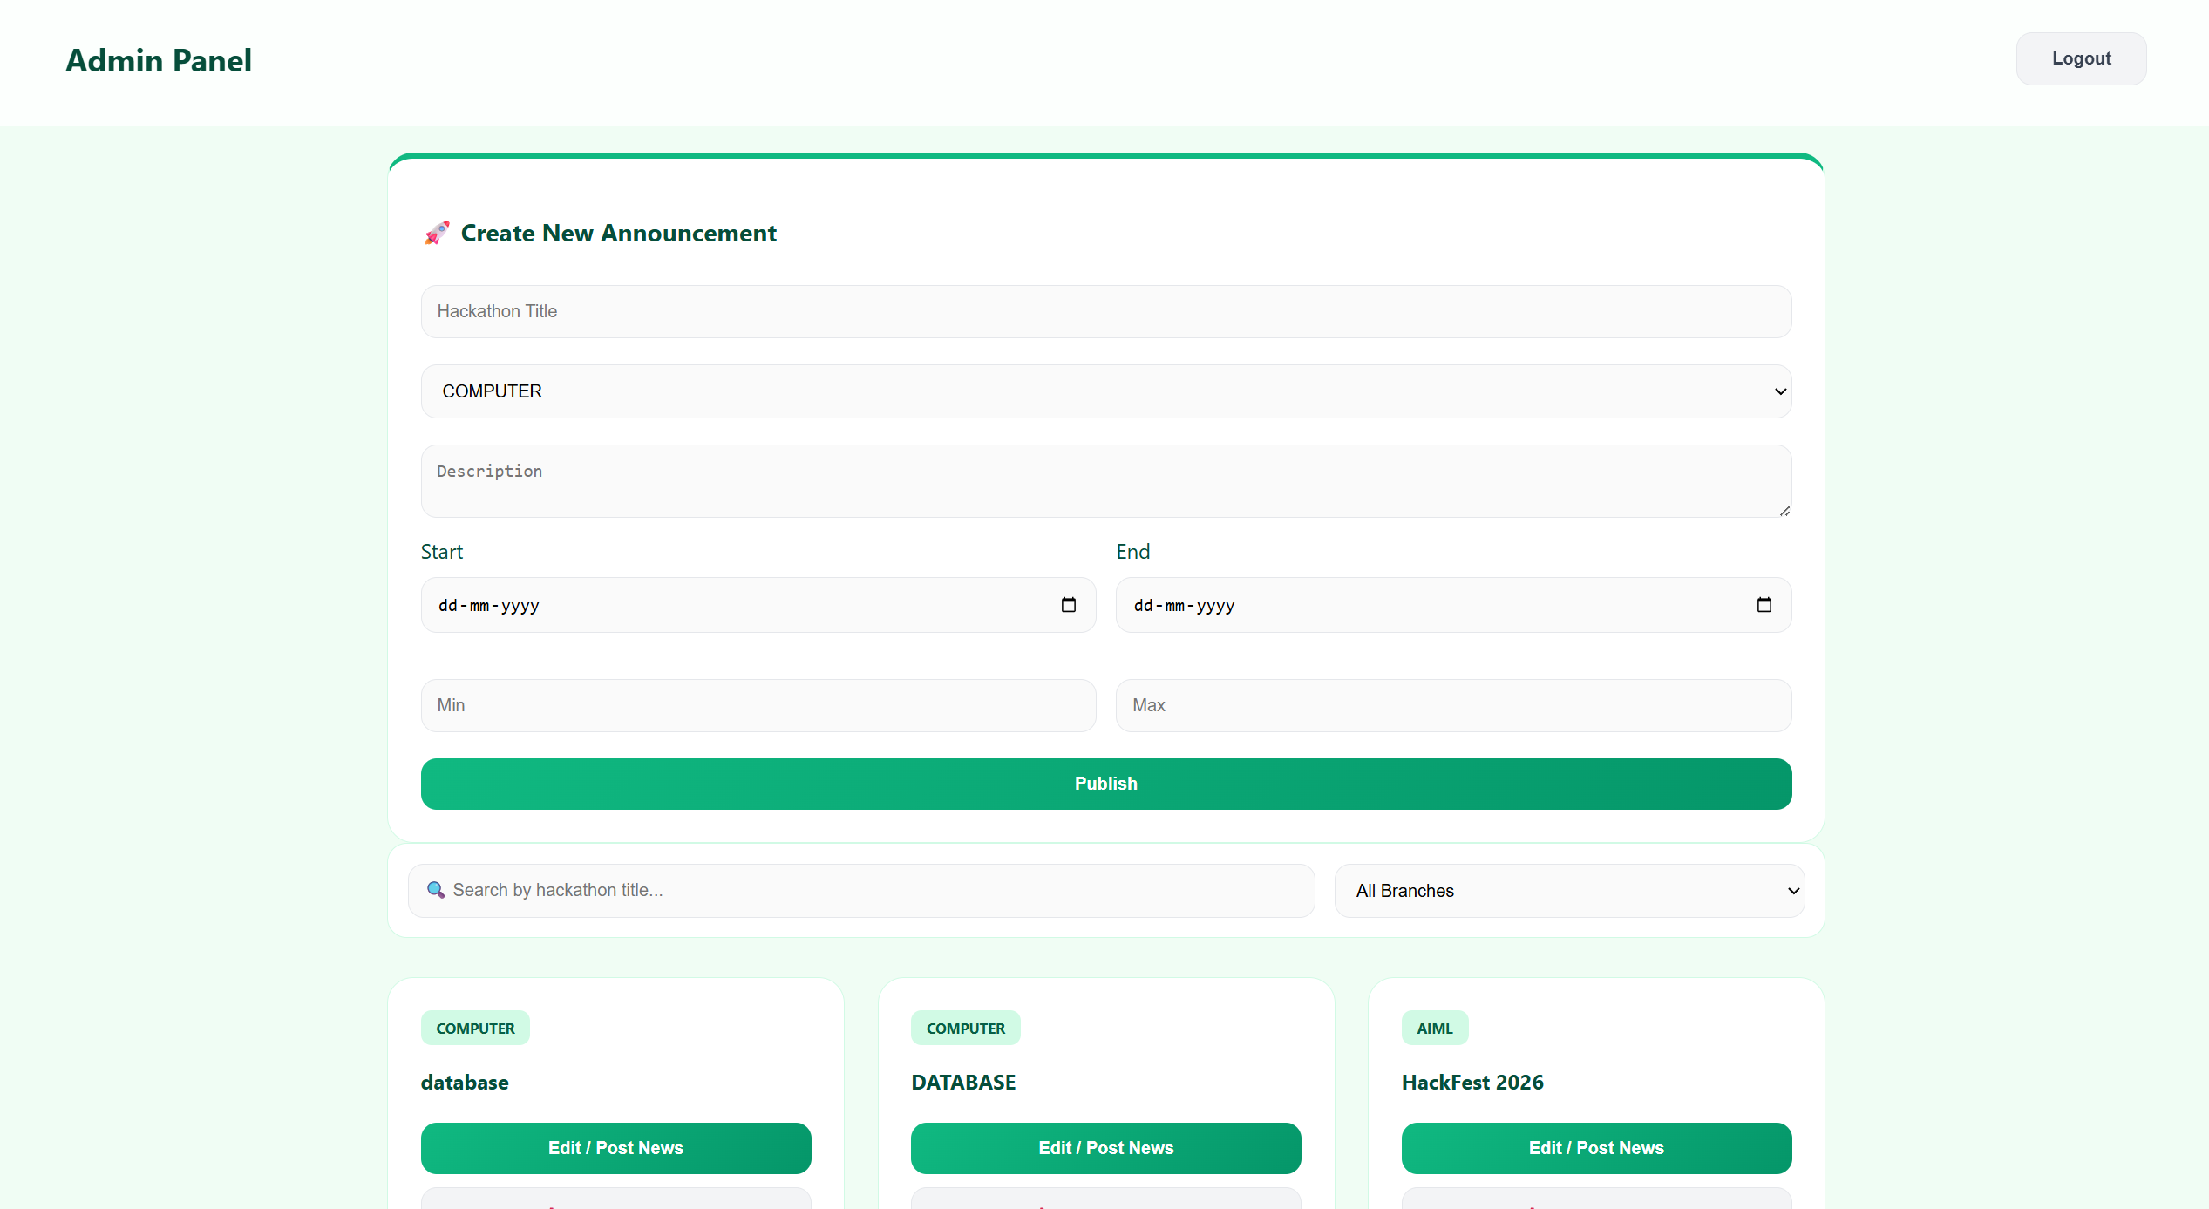

Slide 15
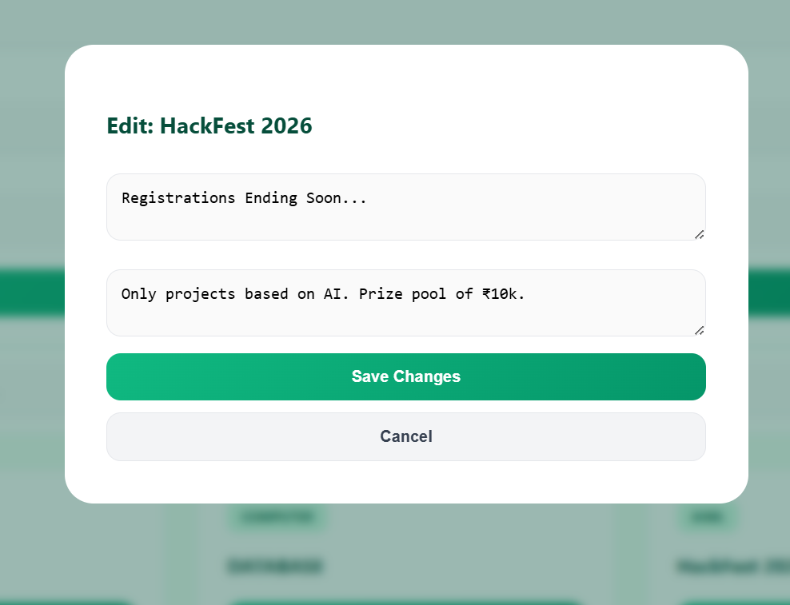
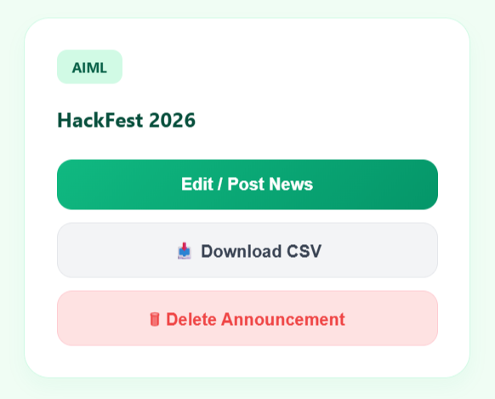

Slide 16
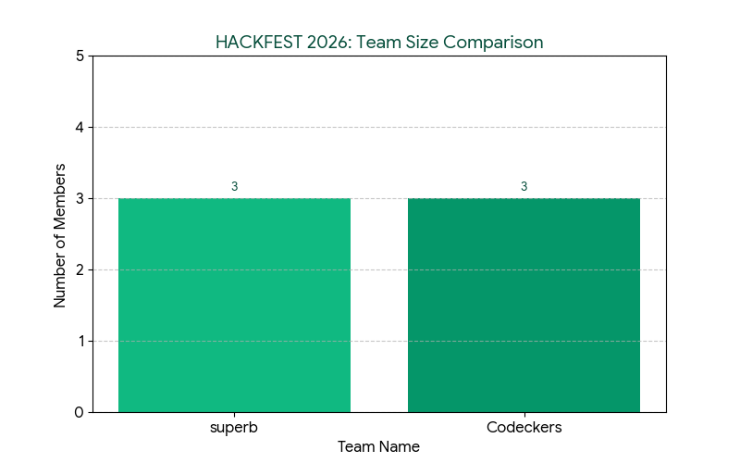
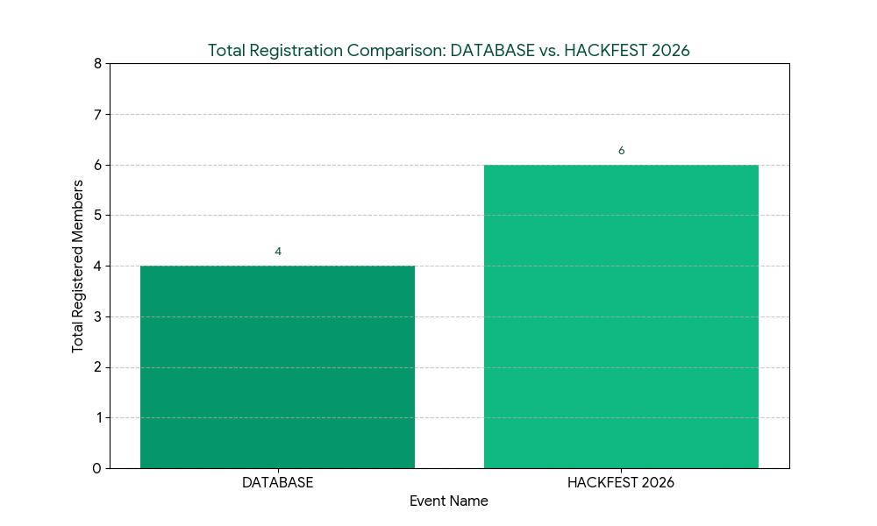
Results & Analysis

Slide 17
Conclusion and Future work
Conclusion
The Centralized Hackathon Management Portal provides a simple and efficient way to manage and participate in hackathons. It allows admins to easily create and control events, while students can quickly view and register without unnecessary steps. Features like automated event handling, team registration, and CSV export reduce manual work and improve user experience. Overall, the system makes hackathon management more organized, accessible, and user-friendly.
Scope of Improvement
Advanced Modules: Potential for future integration of automated judging systems or real-time leaderboards, scheduled hackathon announcements, etc.
Enhanced Features: Expanding the portal to include team-formation tools and automated certificate generation for participants.

Slide 18
References
Research papers
_x000b_[1] “Centralized Hackathon Management System,” International Journal of Engineering Research Science & Technology (IJERST). [Online]. Available: https://ijerst.org/index.php/ijerst/article/view/1624/1464
[2] “Hackathon-based Innovation and Learning,” ScienceDirect, 2024. [Online]. Available: https://www.sciencedirect.com/science/article/pii/S2444569X24000404
[3] Falk, et al., “Hackathon Planning Kit,” IEEE Access, 2024. [Online]. Available: https://hackathon-planning-kit.org/files/Falk-IEEEAccess-2024.pdf

Slide 19
Thank You...!!

